Slide 1
News Scraper Dashboard Usability Testing
Adam Fairlie

Slide 2
Background Information
Moving from RSS feeds to multiple configurable sources
Creating a configurable web scraper with multiple different source types
Combined with a classifier to categorise news articles
Includes a dashboard to manage the scraper and see results as visualisation
Notes:
Biocaster currently gets its news information from RSS feeds. My individual project is to create a system which is more configurable and can use multiple different information sources, such as website scraping, to curate a wider range of news sources. This will be combined with a classifier to categorise the incoming articles. I am also creating a dashboard so that this system can be managed and you can see a kibana visualisation of the data gathered, which I will demonstrate today.

Slide 3
Functionality
Python-based web scraping system for multiple sources. Can use RSS feeds (using feedparser) and news websites (using newspaper3k) to extract article information
Multi-topic classification using different models to give news articles a category (health, sports, entertainment etc.)
Database for storing information (article headline, body, category, source name, language etc.) using elasticsearch
Visualisation of database information through elastic kibana
Web interface for managing python scraping system (using eel library to connect javascript to python)

Slide 4
Architecture
Web scaping system
Web interface
Classifier
Database
Visualisation

Slide 5
Questionnaire
Short questionnaire (5-10 mins)
https://forms.gle/ZUEmhvvvu8g1vCq87
Can try out live (mock) version of interface
Notes:
After the presentation I will link a short 5-10 minutes questionnaire. If possible could you fill it out whenever possible so I can use the analysis in my dissertation. It’s on the effectiveness of the interface and visualisation. The questionnaire has a link to a mock version of the interface (not connected to scraper) for you to try yourself.

Slide 6
Motivation
Evaluation on kibana visualisation and web interface
Research Questions:
“Does the visualisation provide a complete and effective overview of the data collected?”
“Does the interface allow users to easily and effectively manage the underlying web scraping system?”
Will perform analyses (aggregations, qualitative coding) for dissertation evaluation
Notes:
I wanted to create an easy to use dashboard where you can easily see the sources being used in the system, and add and remove sources, and turn them on and off. You can also see which sources are stale, which was mentioned in my previous meeting as something useful.

Slide 7
Demonstration

Slide 8
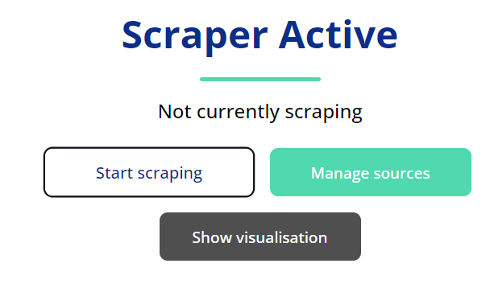
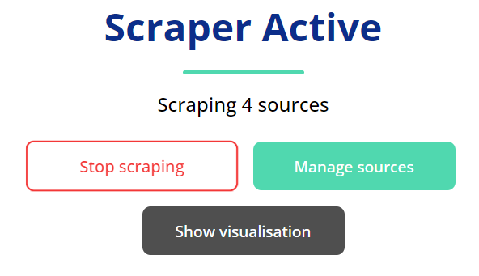
Enabling/disabling
Clicking the start/stop scraping button on the homepage will toggle whether the scraper is running
Notes:
I wanted to create an easy to use dashboard where you can easily see the sources being used in the system, and add and remove sources, and turn them on and off. You can also see which sources are stale, which was mentioned in my previous meeting as something useful.

Slide 9
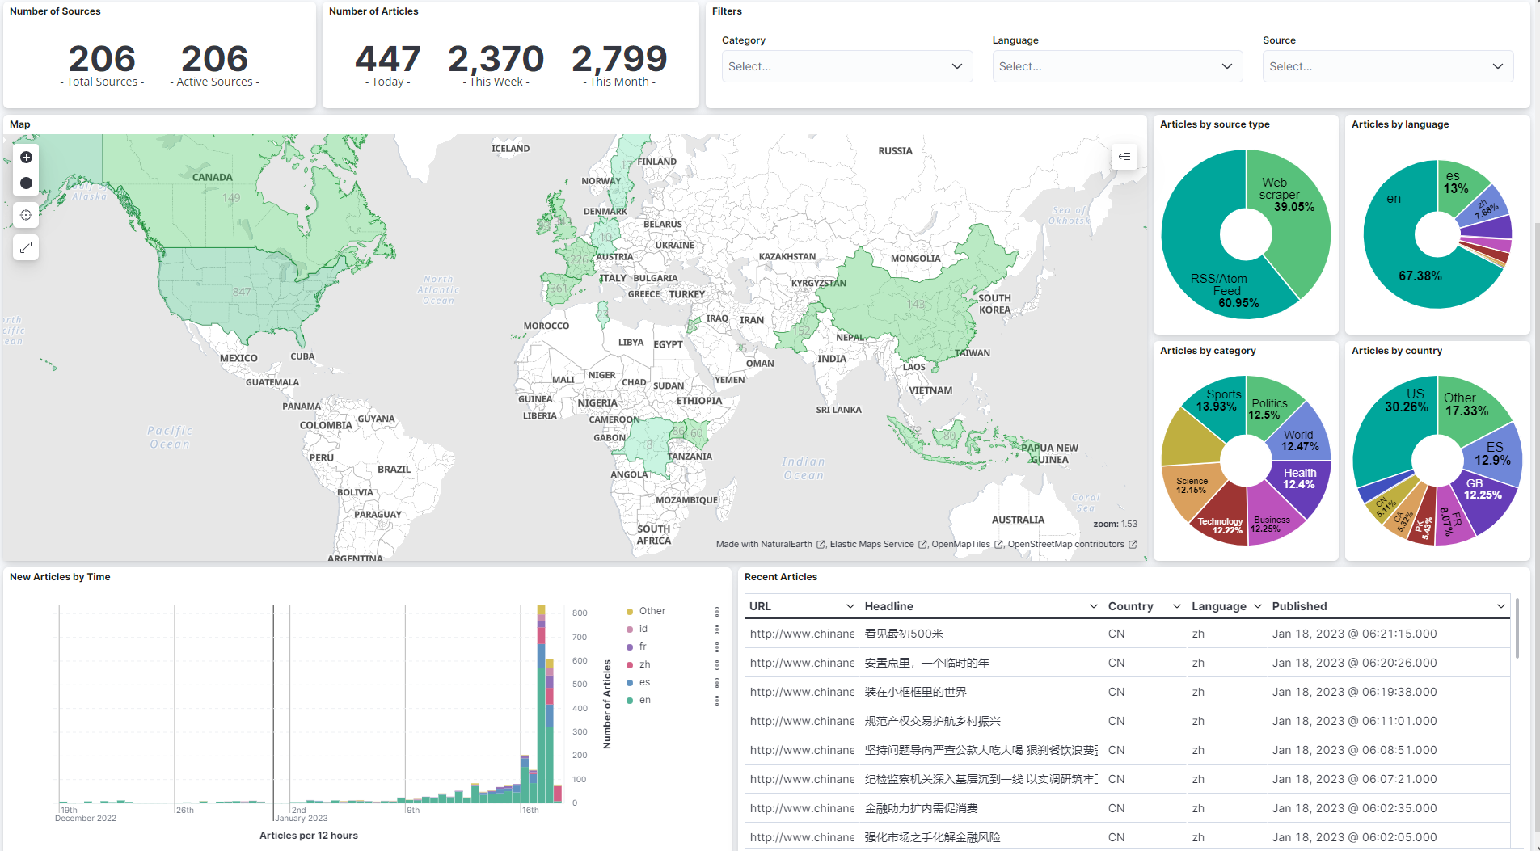
Visualisation
Can be toggled with the show/hide visualisation button
Notes:
I wanted to create an easy to use dashboard where you can easily see the sources being used in the system, and add and remove sources, and turn them on and off. You can also see which sources are stale, which was mentioned in my previous meeting as something useful.

Slide 10
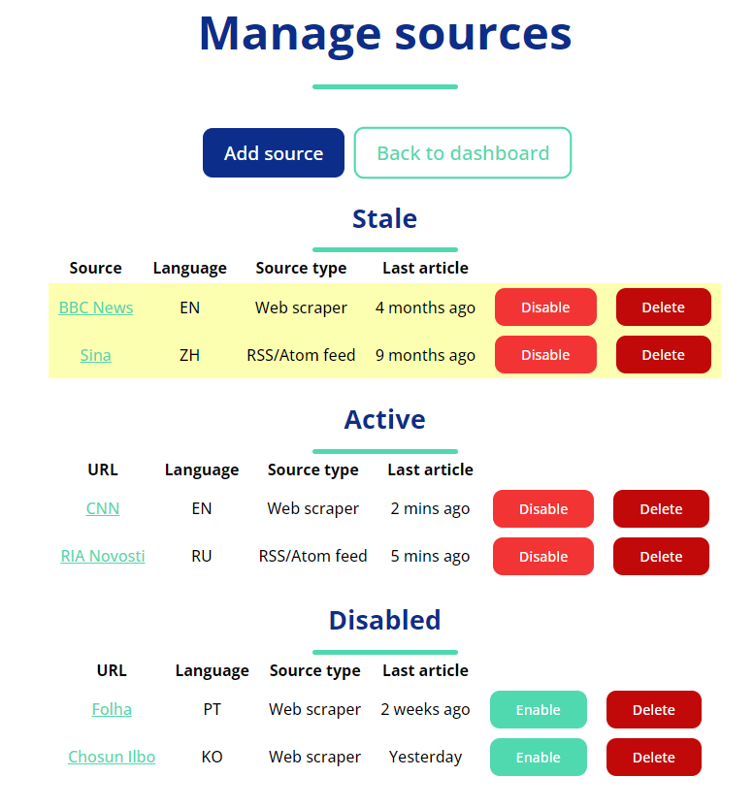
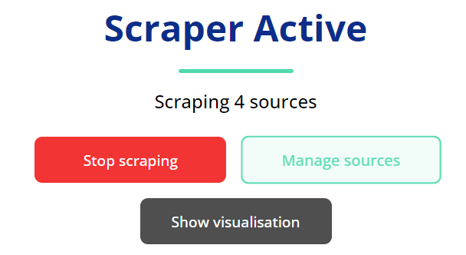
Managing sources
Clicking the “manage sources” button will take you to the manage sources page. You can return to the dashboard with the “back to dashboard” button
Notes:
I wanted to create an easy to use dashboard where you can easily see the sources being used in the system, and add and remove sources, and turn them on and off. You can also see which sources are stale, which was mentioned in my previous meeting as something useful.

Slide 11
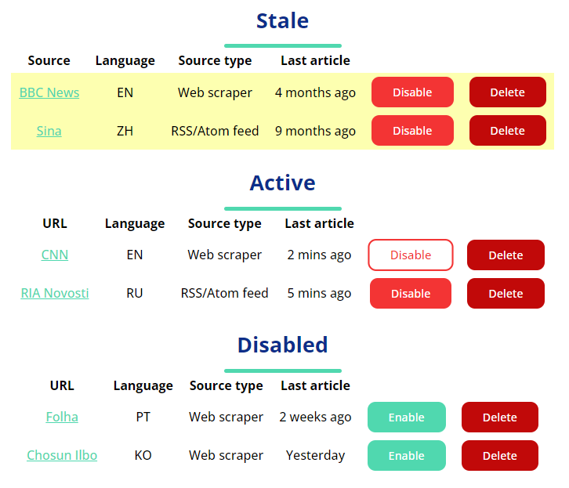
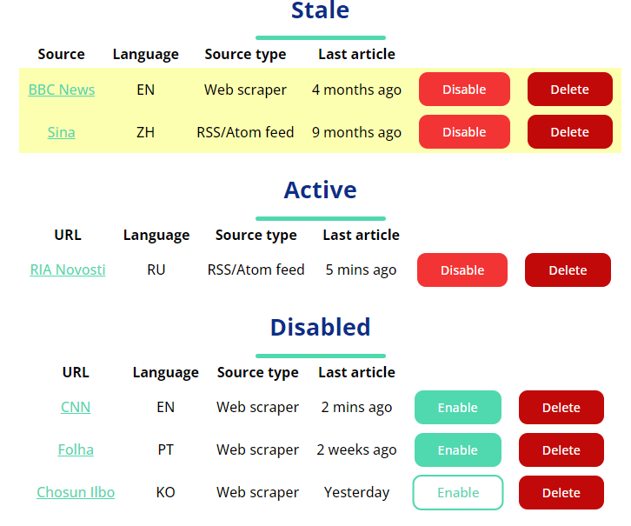
Enabling/disabling sources
Each active source has a disable button next to it, which will add it to the disabled sources. Each disabled source has an enable button, which will add it to the enabled (or stale) sources list
Notes:
I wanted to create an easy to use dashboard where you can easily see the sources being used in the system, and add and remove sources, and turn them on and off. You can also see which sources are stale, which was mentioned in my previous meeting as something useful.

Slide 12
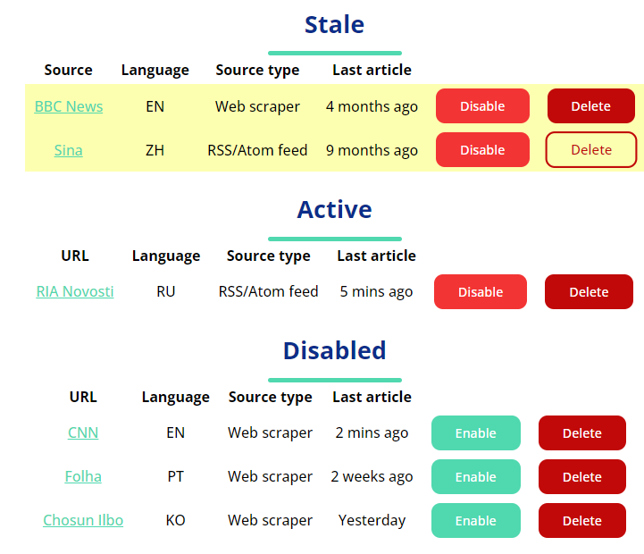
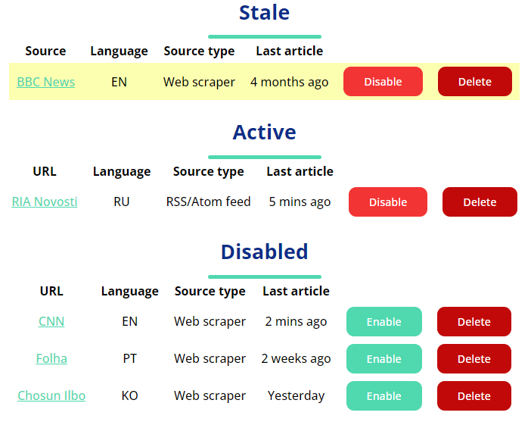
Deleting sources
Each source has a delete button next to it, which will remove the source
Notes:
I wanted to create an easy to use dashboard where you can easily see the sources being used in the system, and add and remove sources, and turn them on and off. You can also see which sources are stale, which was mentioned in my previous meeting as something useful.

Slide 13
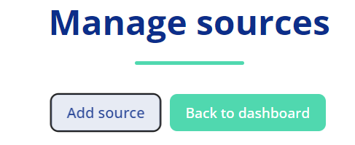
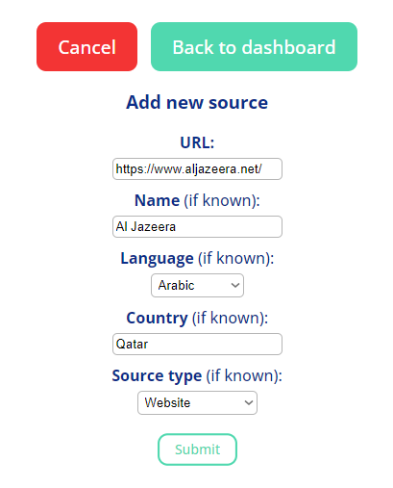
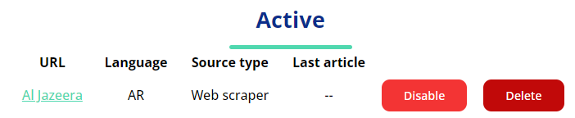
Adding sources
There is an add source button, which will create a form for adding a source. Clicking submit with a URL will create the source. Extra information can be added if known
Notes:
I wanted to create an easy to use dashboard where you can easily see the sources being used in the system, and add and remove sources, and turn them on and off. You can also see which sources are stale, which was mentioned in my previous meeting as something useful.

